Slide 1
CSE477
VLSI Digital Circuits
Fall 2002
Lecture 03: MOS Transistor
Mary Jane Irwin ( www.cse.psu.edu/~mji ) www.cse.psu.edu/~cg477
[Adapted from Rabaey’s Digital Integrated Circuits, ©2002, J. Rabaey et al.]
Notes:
Other handouts
Project Description
Other “assignments”
Bring in a copy of your photo id
Find a “permanent” seat by next Tuesday
To read on your own – 3.1 and 3.2 – Reverse biased diode

Slide 2
Course Administration
Instructor: Mary Jane Irwin mji@cse.psu.edu www.cse.psu.edu/~mji 227 Pond Lab Office Hrs: M 13:30-14:45 & R 9:30-10:45
TA: Vijay Degalahal (and Greg Link) degalaha@cse.psu.edu (link@cse.psu.edu ) 225 Pond Lab (226 Pond Lab) Office Hrs: W & R 17:30 to 19:30 in 101 Pond
Labs: Accounts on 101 Pond Lab machines
URL: www.cse.psu.edu/~cg477
Text: Digital Integrated Circuits, 2nd Edition Rabaey et. al., ©2002 (October)
Handouts: Leftover handouts available outside my office door after class
Notes:
computer accounts are automatic, if have never had an account in CSE I will have (or soon have) a listing of userids/passwords.
seating chart – assignment for Thursday – xerox copy of your photo ID
pick a seat for the semester and sit there (or nearby) for rest of semester
room size -

Slide 3
Review: Fundamental Design Metrics
Functionality
Cost
  NRE (fixed) costs - design effort
  RE (variable) costs - cost of parts, assembly, test
Reliability, robustness
  Noise margins
  Noise immunity
Performance
  Speed (delay)
  Power consumption; energy
Time-to-market
Notes:
RE costs - silicon processing, packaging, test
proportional to product volume and chip area
NRE - non recurring engineering - one time cost factor
design time and effort, mask generation

Slide 4
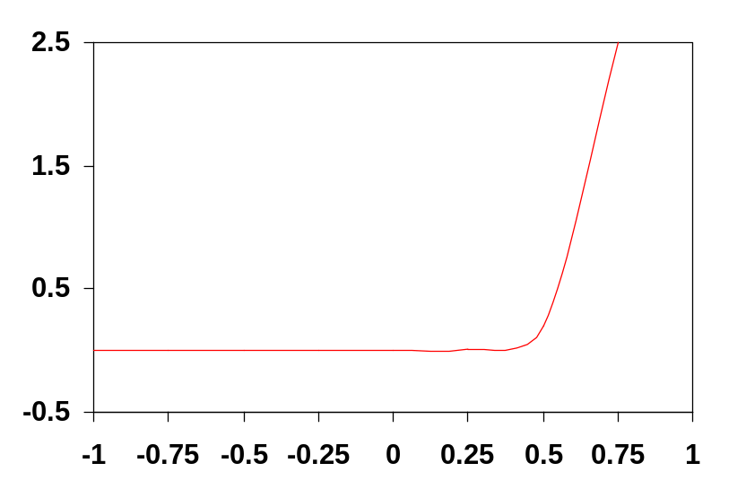
Review: Reverse Bias Diode
The ideal diode equation (for both forward and reverse-bias conditions) is
I_{D} = I_{S}(e ^{V}D^{/ φ}T – 1)
where V_{D} is the voltage applied to the junction
  a forward-bias lowers the potential barrier allowing carriers to flow across the diode junction
  a reverse-bias raises the potential barrier and the diode becomes nonconducting
φ_{T} = kT/q = 26mV at 300K
I_{S} is the saturation current of the diode
+
V_{D}
-
I_{D} (mA)
V_{D} (V)
Notes:
In reverse-bias the diode has only drift current which can (almost) be ignored.
Is is the (constant value) saturation current – proportional to the area of the diode and a function of the doping levels and widths of the neutral regions. In actual devices, the reverse current is substantially larger than IS.

Slide 5
Review: Design Abstraction Levels
SYSTEM
MODULE
+
GATE
CIRCUIT
CIRCUIT
V_{in}
V_{in}
V_{out}
V_{out}
DEVICE
G
S
D
n+
n+

Slide 6
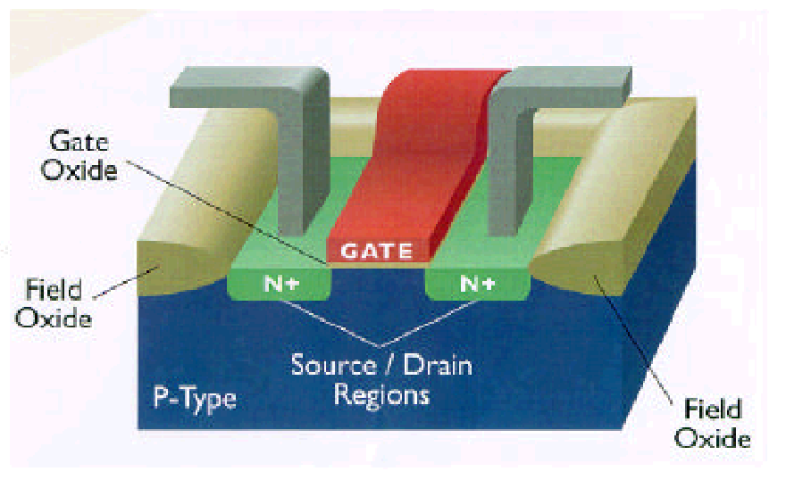
The MOS Transistor
Polysilicon
Aluminum

Slide 7
The NMOS Transistor Cross Section
n areas have been doped with donor ions (arsenic) of concentration N_{D} - electrons are the majority carriers
Gate oxide
Polysilicon Gate
W
Source
Drain
Field-Oxide
(SiO₂)
n+
n+
L
p substrate
p+ stopper
Bulk (Body)
p areas have been doped with acceptor ions (boron) of concentration N_{A} - holes are the majority carriers
Notes:
Starting at the bottom of the design abstraction chart
Gate Oxide – insulator
NMOS – since carriers are electrons (n type carriers)
M – metal; O – oxide; S – semiconductor
Field oxide isolates one device from neighboring devices
Base technology for the semester
0.25 micron transistor length L (drawn separation from source to drain) – 0.24 effective
1.0 micron transistor width W for minimum size transistor
2.5V supply voltage VDD
0.43 (-0.4) threshold voltage for NMOS (PMOS) devices
so
min W/L ratio in max for 250nm technology is 1/.24
View transistor as a switch with an infinite off-resistance and a finite on-resistance

Slide 8
Switch Model of NMOS Transistor
| V_{GS} |
Gate
Source
(of carriers)
Drain
(of carriers)
Open (off) (Gate = ‘0’)
Closed (on) (Gate = ‘1’)
R_{on}
| V_{GS} | < | V_{T} |
| V_{GS} | > | V_{T} |
Notes:
Fourth terminal, body (bulk on previous slide)- substrate, not shown.
Assumed connected to the appropriate supply rail, GND for NMOS, VDD for PMOS
Electrons flow from source to drain – so current is referenced drain to source (IDS)
Performs very well as a switch, little parasitic effects
Today: STATIC (steady-state view) and later DYNAMIC (transient view)
VGS < 0.43 V for off
VGS > 0.43 V for on

Slide 9
Switch Model of PMOS Transistor
Gate
| V_{GS} |
Source
(of carriers)
Drain
(of carriers)
Open (off) (Gate = ‘1’)
Closed (on) (Gate = ‘0’)
R_{on}
| V_{GS} | > | V_{DD} – | V_{T} | |
| V_{GS} | < | V_{DD} – |V_{T}| |
Notes:
holds flow source to drain – so current is referenced source to drain (ISD)
VGS > 2.5 - .4 = 2.1 V for off
and Vgs < 2.1 V for on

Slide 10
Threshold Voltage Concept
G
V_{GS}
+
S
D
-
n+
n+
depletion region
n channel
p substrate
B
The value of V_{GS} where strong inversion occurs is called the threshold voltage, V_{T}
Notes:
Conductivity of the channel is modulated by the gate voltage - the larger the voltage difference between the gate and the source, the smaller the resistance of the conducting channel and the larger the current
When VGS = 0 and the drain, source, and bulk are all connected to ground, the drain and source are connected by back-to-back pn-junctions (substrate-source and substrate-drain) - both are off (reverse biased)resulting in an extremely high resistance between drain and source with no VGS

Slide 11
The Threshold Voltage
V_{T} = V_{T0} + γ(√|-2φ_{F} + V_{SB}| - √|-2φ_{F}|)
where
V_{T0} is the threshold voltage at V_{SB} = 0 and is mostly a function of the manufacturing process
  Difference in work-function between gate and substrate material, oxide thickness, Fermi voltage, charge of impurities trapped at the surface, dosage of implanted ions, etc.
V_{SB} is the source-bulk voltage
φ_{F} = -φ_{T}ln(N_{A}/n_{i}) is the Fermi potential (φ_{T} = kT/q = 26mV at 300K is the thermal voltage; N_{A} is the acceptor ion concentration; n_{i} ≈ 1.5x10¹⁰ cm⁻³ at 300K is the intrinsic carrier concentration in pure silicon)
γ = √(2qε_{si}N_{A})/C_{ox} is the body-effect coefficient (impact of changes in V_{SB}) (ε_{si}=1.053x10⁻¹⁰F/m is the permittivity of silicon; C_{ox} = ε_{ox}/t_{ox} is the gate oxide capacitance with ε_{ox}=3.5x10⁻¹¹F/m)
Notes:
Value of VGS where strong inversion occurs is VT
VSB is the source to bulk (body) or substrate bias (note relationship to body effect)
For tox = 5 nm then Cox = 7fF/micron^2 (typical tox less than 10nm (==100 angstroms) in today’s technology)
Typical values for NA = 10**15 atoms/cm**3 and ND = 10**16 atoms/cm**3
Observe that the threshold voltage has a positive value for a normal NMOS device and a negative for a normal PMOS device

Slide 12
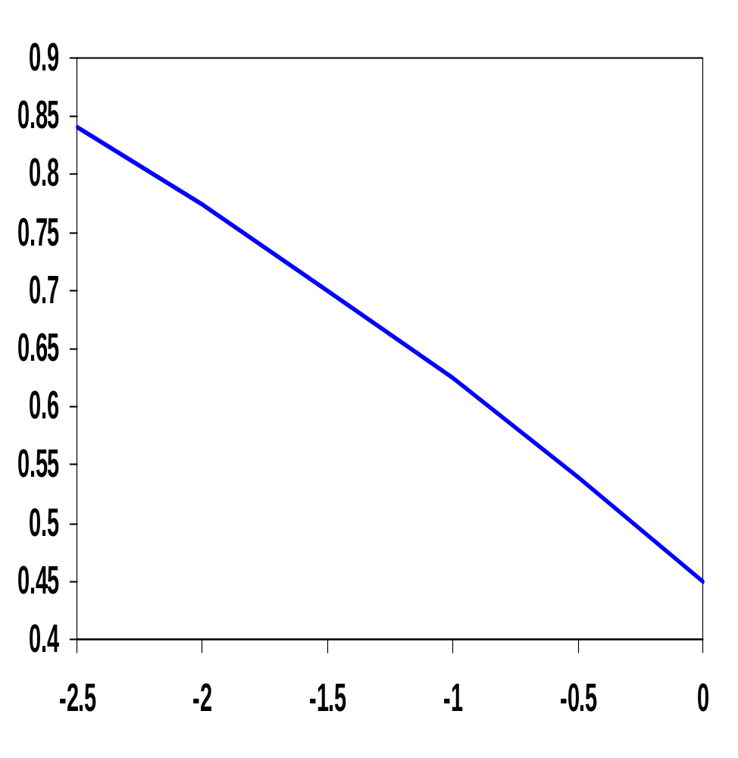
The Body Effect
V_{SB} is the substrate bias voltage (normally positive for n-channel devices with the body tied to ground)
A negative bias causes V_{T} to increase from 0.45V to 0.85V
V_{T} (V)
V_{BS} (V)
Notes:
Well bias on VT for NMOS (0.25 micron, 2.5V Vdd)
|-2phiF| = 0.6V and gamma = 0.4 V**1/2
A negative bias on the well/substrate causes the threshold to increase from 0.45V to 0.85V
Can use this trick to help with power consumption – reduces leakage currents (but slows down the gate)
VSB always has to be larger than –0.6V in an NMOS device; otherwise the source-body diode becomes forward biased

Slide 13
Transistor in Linear Mode
Assuming V_{GS} > V_{T}
V_{GS}
G
V_{DS}
S
D
I_{D}
n+
-
+
n+
V(x)
x
B
The current is a linear function of both V_{GS} and V_{DS}
Notes:
Assume now that VGS > VT and a small voltage VDS is applied between drain and source. The voltage difference causes a current ID to flow from drain to source.
At a point x along the channel, the voltage is V(x) and the gate-to-channel voltage at that point equals VGS – V(x)

Slide 14
Voltage-Current Relation: Linear Mode
For long-channel devices (L > 0.25 micron)
When V_{DS} ≤ V_{GS} – V_{T}
I_{D} = k’_{n} W/L [(V_{GS} – V_{T})V_{DS} – V_{DS}²/2]
where
k’_{n} = μ_{n}C_{ox} = μ_{n}ε_{ox}/t_{ox} = is the process transconductance parameter (μ_{n} is the carrier mobility (m²/Vsec))
k_{n} = k’_{n} W/L is the gain factor of the device
For small V_{DS}, there is a linear dependence between V_{DS} and I_{D}, hence the name resistive or linear region
Notes:
AKA: Triode, Resistive and Nonsaturated
Cox is the capacitance per unit area of the gate oxide; 10nm (=100 Angstroms) or smaller for contemporary processes.
For an oxide thickness of 5nm, Cox is 7 fF/um**2
Eox is the oxide permittivity = 3.97 x e0 = 3.5 x 10**-11 F/m
So k’n = 88uA/V**2 and k’p = 32uA/V**2 for old technology values – notice the 2 to 3 ratio between k’n and k’p
Current is a function of BOTH the gate (VGS) and drain (VDS) voltages
Displays a continuous conductive channel between source and drain regions
W and L are the effective channel width and length; Wd and Ld are the drawn dimensions

Slide 15
Transistor in Saturation Mode
Assuming V_{GS} > V_{T}
V_{GS}
V_{DS} > V_{GS} - V_{T}
S
G
V_{DS}
D
I_{D}
n+
n+
-
V_{GS} - V_{T}
+
Pinch-off
B
The current remains constant (saturates).
Notes:
As VDS is increased, the assumption that the channel voltage is larger than the threshold all along the channel ceases to hold when VGS – V(x) < VT
At this point, the induced charge is zero and the conducting channel disappears or is pinched off.
No channel exists in the vicinity of the drain region (VGS - VDS <= VT)
The voltage difference over the induced channel remains fixed (at VGS -VT) and the current remains constant (or saturates)

Slide 16
Voltage-Current Relation: Saturation Mode
For long channel devices
When V_{DS} ≥ V_{GS} – V_{T}
I_{D}’ = k’_{n}/2 W/L [(V_{GS} – V_{T}) ²]
since the voltage difference over the induced channel (from the pinch-off point to the source) remains fixed at V_{GS} – V_{T}
However, the effective length of the conductive channel is modulated by the applied V_{DS}, so
I_{D} = I_{D}’ (1 + λV_{DS})
where λ is the channel-length modulation (varies with the inverse of the channel length)
Notes:
So the current remains constant – or saturates – so it is no longer a function of VDS
Increasing VDS causes the depletion region at the drain junction to grow, reducing the length of the channel; the current increases when L decreases
Lambda varies roughly with the inverse of the channel length.
In shorter transistors, the drain-junction depletion region presents a larger fraction of the channel, and the channel-length modulation effect is more pronounced.
Current is a function of gate voltage.

Slide 17
Current Determinates
For a fixed V_{DS} and V_{GS} (> V_{T}), I_{DS} is a function of
  the distance between the source and drain – L
  the channel width – W
  the threshold voltage – V_{T}
  the thickness of the SiO₂ – t_{ox}
  the dielectric of the gate insulator (SiO₂) – ε_{ox}
  the carrier mobility
    for nfets: μ_{n} = 500 cm²/V-sec
    for pfets: μ_{p} = 180 cm²/V-sec

Slide 18
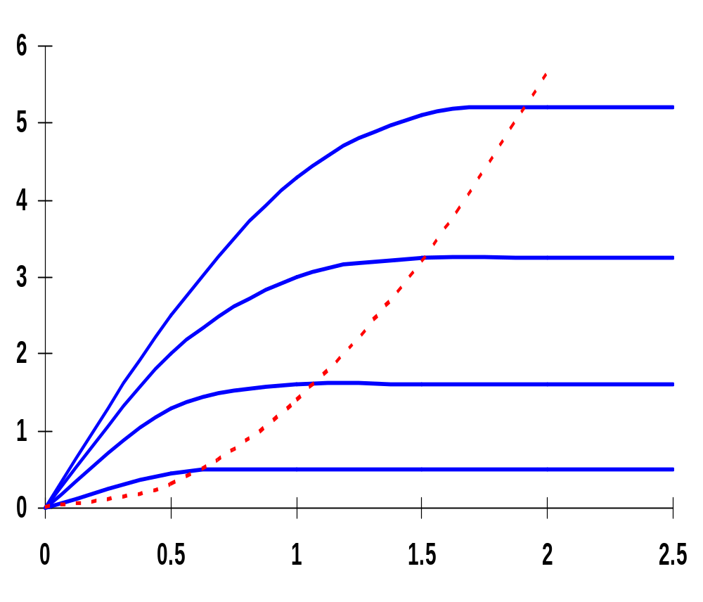
Long Channel I-V Plot (NMOS)
X 10⁻⁴
V_{GS} = 2.5V
V_{DS} = V_{GS} - V_{T}
V_{GS} = 2.0V
I_{D} (A)
Linear
Saturation
Quadratic dependence
V_{GS} = 1.5V
V_{GS} = 1.0V
cut-off
V_{DS} (V)
NMOS transistor, 0.25um, L_{d} = 10um, W/L = 1.5, V_{DD} = 2.5V, V_{T} = 0.4V
Notes:
Ld is drawn length
In resistive region, behaves like a voltage-controlled resistor
In saturated region, acts as a voltage-controlled current source (ignoring channel-length modulation)
Notice the squared dependence of ID as a function of VGS in saturation that is clearly observable from the spacing between the different curves

Slide 19
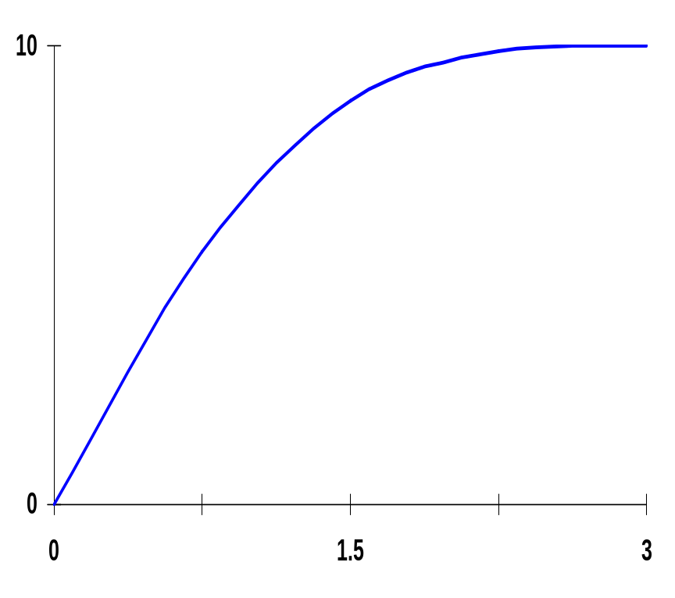
Short Channel Effects
Behavior of short channel device mainly due to
5
υ_{sat} =10⁵
Constant velocity
Velocity saturation – the velocity of the carriers saturates due to scattering (collisions suffered by the carriers)
υ_{n} (m/s)
Constant mobility
(slope = μ)
ξ_{c}=
ξ(V/μm)
For an NMOS device with L of .25μm, only a couple of volts difference between D and S are needed to reach velocity saturation
Notes:
Normally, the velocity of the carriers is proportional to the electric field – carrier mobility is constant.
However, at high field strengths, carriers fail to follow this linear model.
For p-type silicon (nfets), the critical field at which electron saturation occurs is around 1.5 x10**6 V/m (1.5 V/um) and vsat ~ 10**5 m/s
Holes in a n-type silicon saturate at the same velocity, although a higher electric field is needed to achieve velocity saturation.
So velocity saturation effects are less pronounced in pfets.
For a 0.25 micron NMOS device are only about 2 volts between the drain and source are needed to reach velocity saturation

Slide 20
Voltage-Current Relation: Velocity Saturation
For short channel devices
Linear: When V_{DS} ≤ V_{GS} – V_{T}
I_{D} = κ(V_{DS}) k’_{n} W/L [(V_{GS} – V_{T})V_{DS} – V_{DS}²/2]
where
κ(V) = 1/(1 + (V/ξ_{c}L)) is a measure of the degree of velocity saturation
Saturation: When V_{DS} = V_{DSAT} ≥ V_{GS} – V_{T}
I_{DSat} = κ(V_{DSAT}) k’_{n} W/L [(V_{GS} – V_{T})V_{DSAT} – V_{DSAT}²/2]
Notes:
For large L or small VDS, K approaches 1.
For short channel devices, K is small than 1 which means that the delivered current, even in the linear region, is smaller than what would normally be expected!
VDSAT = k(VGT) VGT so further increasing VDS does not yield more current

Slide 21
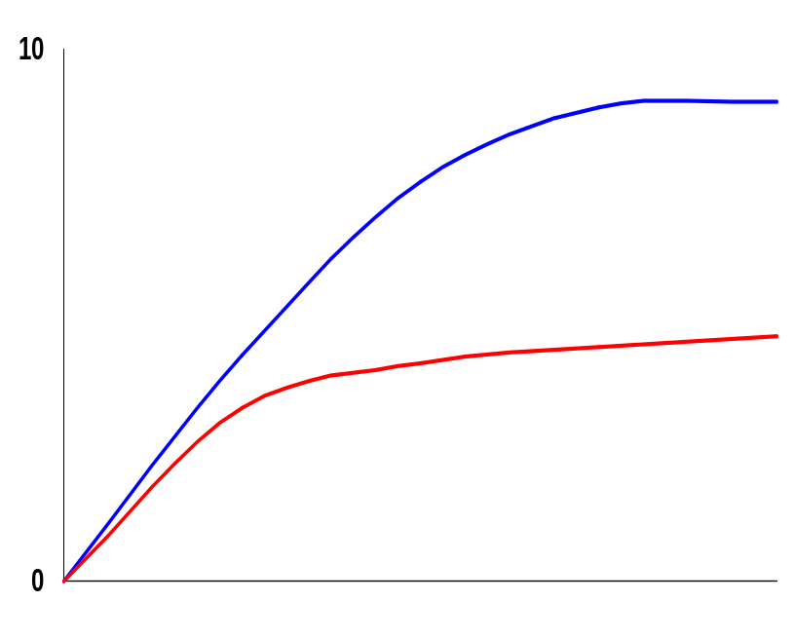
Velocity Saturation Effects
V_{GS} = V_{DD}
Long channel devices
For short channel devices and large enough V_{GS} – V_{T}
V_{DSAT} < V_{GS} – V_{T} so the device enters saturation before V_{DS} reaches V_{GS} – V_{T} and operates more often in saturation
Short channel devices
V_{DSAT}
V_{GS}-V_{T}
I_{DSAT} has a linear dependence wrt V_{GS} so a reduced amount of current is delivered for a given control voltage
Notes:
Other effects in play as well – like mobility degradation (that reduces the surface mobility of the carriers wrt bulk mobility)
On the other hand, reducing the supply voltage does not have as significant an effect (as it does in long-channel devices).

Slide 22
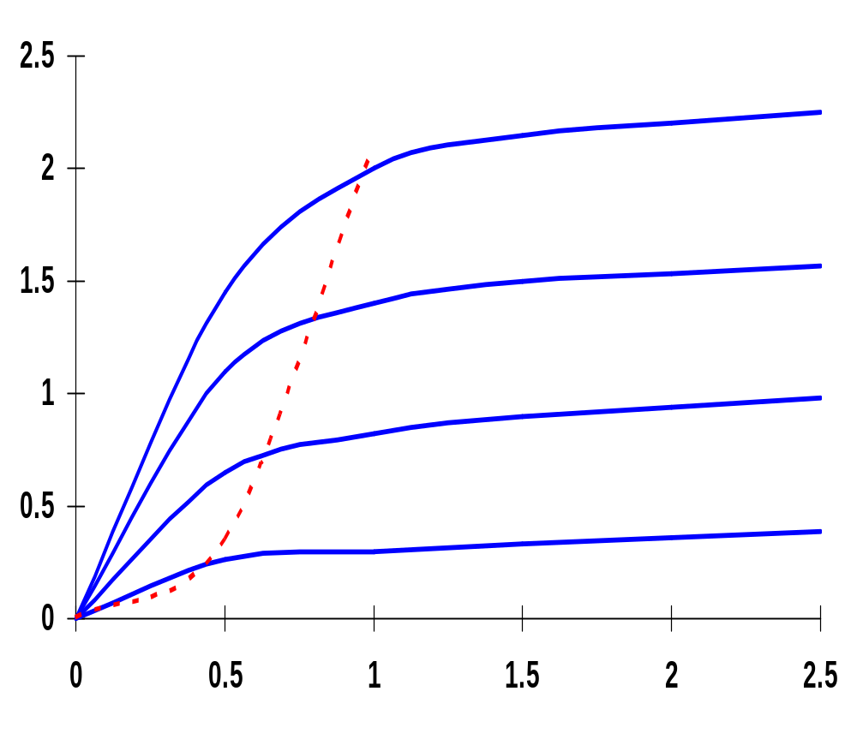
Short Channel I-V Plot (NMOS)
X 10⁻⁴
Early Velocity
Saturation
V_{GS} = 2.5V
V_{GS} = 2.0V
I_{D} (A)
Linear
Saturation
V_{GS} = 1.5V
Linear dependence
V_{GS} = 1.0V
V_{DS} (V)
NMOS transistor, 0.25um, L_{d} = 0.25um, W/L = 1.5, V_{DD} = 2.5V, V_{T} = 0.4V
Notes:
Ld is drawn length
Linear dependence of saturation current wrt VGS
Velocity saturation causes device to saturate for substantially smaller values of VDS.
Results in a substantial drop in current drive for high voltage levels.
Eg at VGS = 2.5V and VDS = 2.5V, the drain current of the short channel device is only 40% of the corresponding value of the long channel device (220 uA versus 540 uA)

Slide 23
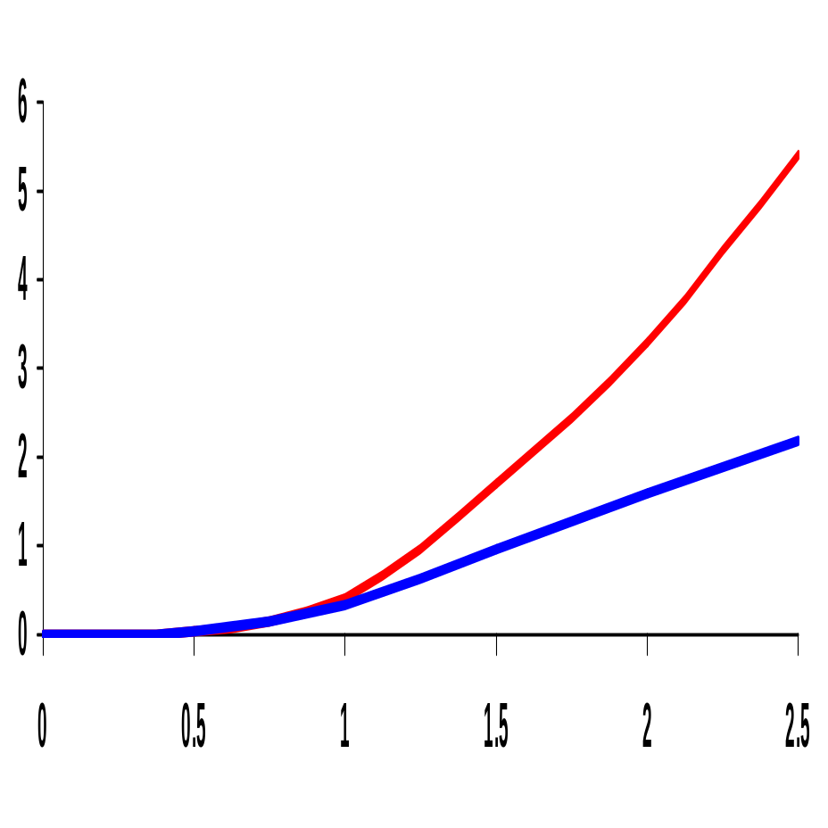
MOS I_{D}-V_{GS} Characteristics
X 10⁻⁴
Linear (short-channel) versus quadratic (long-channel) dependence of I_{D} on V_{GS} in saturation
Velocity-saturation causes the short-channel device to saturate at substantially smaller values of V_{DS} resulting in a substantial drop in current drive
long-channel quadratic
I_{D} (A)
short-channel linear
V_{GS} (V)
(for V_{DS} = 2.5V, W/L = 1.5)

Slide 24
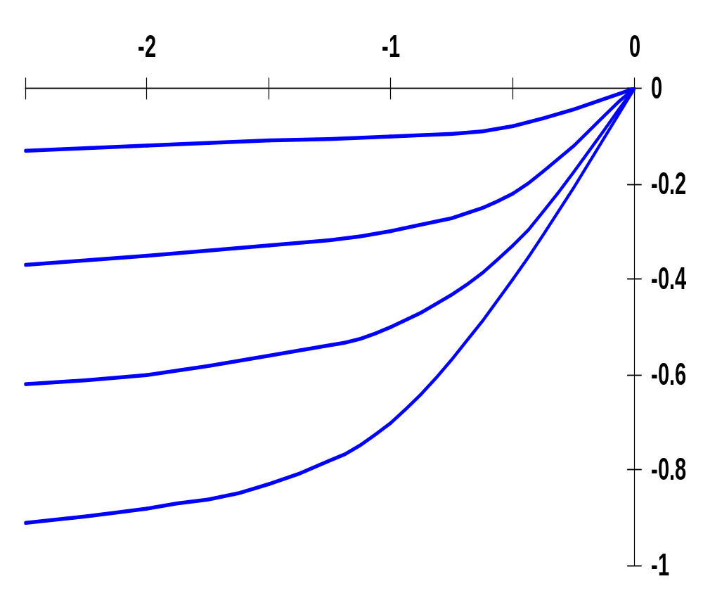
Short Channel I-V Plot (PMOS)
All polarities of all voltages and currents are reversed
V_{DS} (V)
V_{GS} = -1.0V
V_{GS} = -1.5V
I_{D} (A)
V_{GS} = -2.0V
V_{GS} = -2.5V
X 10⁻⁴
PMOS transistor, 0.25um, L_{d} = 0.25um, W/L = 1.5, V_{DD} = 2.5V, V_{T} = -0.4V
Notes:
All the derived equations hold for PMOS – for PMOS devices the polarities of all voltages and currents are reversed
Due to lower mobility, the maximum current is only 42% of what is achieved by a similar NMOS transistor
Effects of velocity saturation are less pronounced than in NMOS (smaller mobility of holes act electrons)

Slide 25
The MOS Current-Source Model
G
I_{D} = 0 for V_{GS} – V_{T} ≤ 0
I_{D} = k’ W/L [(V_{GS} – V_{T})V_{min}–V_{min}²/2](1+λV_{DS}) for V_{GS} – V_{T} ≥ 0
with V_{min} = min(V_{GS} – V_{T}, V_{DS}, V_{DSAT})
and V_{GT} = V_{GS} - V_{T}
I_{D}
S
D
B
Determined by the voltages at the four terminals and a set of five device parameters
 | V_{T0}(V) | γ(V^{0.5}) | V_{DSAT}(V) | k’(A/V²) | λ(V⁻¹)
NMOS | 0.43 | 0.4 | 0.63 | 115 x 10⁻⁶ | 0.06
PMOS | -0.4 | -0.4 | -1 | -30 x 10⁻⁶ | -0.1
Notes:
For the generic 0.25 micron, minimum length device
.4 and -.4 are the body-effect coefficients

Slide 26
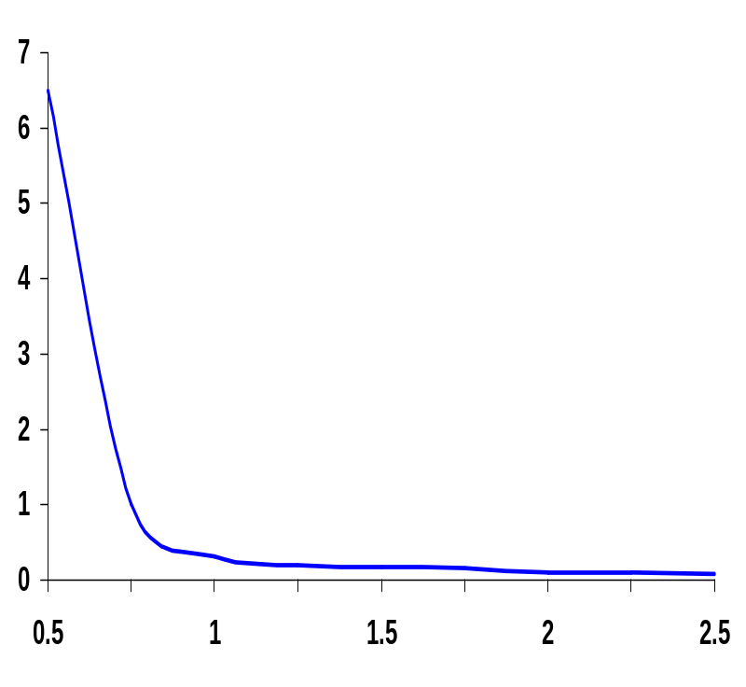
The Transistor Modeled as a Switch
x10⁵
Modeled as a switch with infinite off resistance and a finite on resistance, R_{on}
V_{GS} ≥ V_{T}
R_{on}
S
D
Resistance inversely proportional to W/L (doubling W halves R_{on})
For V_{DD}>>V_{T}+V_{DSAT}/2, R_{on} independent of V_{DD}
Once V_{DD} approaches V_{T}, R_{on} increases dramatically
R_{eq} (Ohm)
V_{DD} (V)
(for V_{GS} = V_{DD}, V_{DS} = V_{DD} →V_{DD}/2)
V_{DD}(V) | 1 | 1.5 | 2 | 2.5
NMOS(kΩ) | 35 | 19 | 15 | 13
PMOS (kΩ) | 115 | 55 | 38 | 31
R_{on} (for W/L = 1)
For larger devices divide R_{eq} by W/L
Notes:
Switch with an infinite off-resistance and a finite on-resistance
Unfortunately, Ron is time-variant, non-linear and depends on operating point
Once the supply voltage approaches VT, a dramatic increase in resistance is observed
Table gives equivalent resistance Req (W/L =1) in 0.25 micron CMOS process (with L = Lmin).
For larger devices, divide Req by W/L = doubling the transistor width halves the resistance

Slide 27
Other (Submicon) MOS Transistor Concerns
Velocity saturation
Subthreshold conduction
  Transistor is already partially conducting for voltages below V_{T}
Threshold variations
  In long-channel devices, the threshold is a function of the length (for low V_{DS})
  In short-channel devices, there is a drain-induced threshold barrier lowering at the upper end of the V_{DS} range (for low L)
Parasitic resistances
  resistances associated with the source and drain contacts
Latch-up
G
S
D
R_{S}
R_{D}
Notes:
Subthreshold conduction - the transition from on to off is not abrupt, but gradual

Slide 28
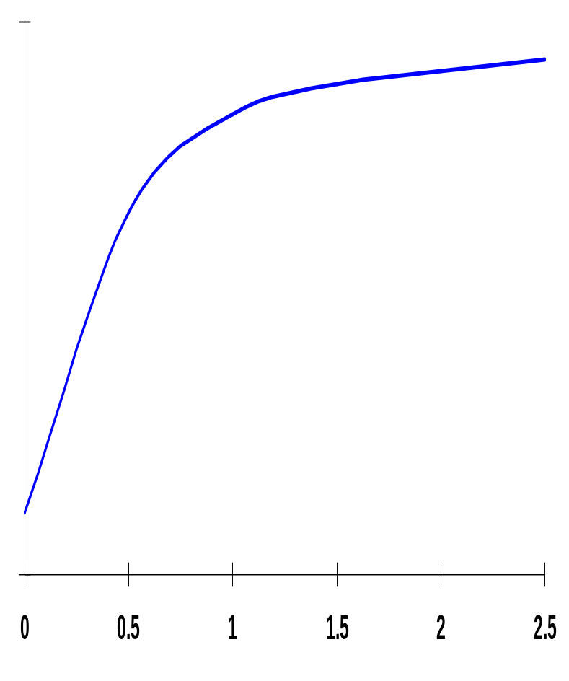
Subthreshold Conductance
10⁻²
Transition from ON to OFF is gradual (decays exponentially)
Current roll-off (slope factor) is also affected by increase in temperature
S = n (kT/q) ln (10)
(typical values 60 to 100 mV/decade)
Has repercussions in dynamic circuits and for power consumption
Linear region
Quadratic region
I_{D} (A)
Subthreshold exponential region
V_{T}
10⁻¹²
V_{GS} (V)
I_{D} ~ I_{S} e ^{(qV}GS^{/nkT)} where n ≥ 1
Notes:
Log scale
Presence of subthreshold current is undesirable because it deviates from the ideal switch-like behavior.
Slope factor – measures by how much VGS has to be reduced for the drain current to drop by a factor of 10.
IS and n are empirical parameters, with n >= 1 and typically ranging around 1.5. For an ideal transistor with the sharpest possible roll-off, n = 1 (where S = 60 mV/decade which means that the subthreshold current drops by a factor of 10 for a reduction in VGS of 60mV). Unfortunately, n is more like 1.5 for actual devices (so S = 90 mV/decade).. The current roll-off is further decreased by a rise in the operating temperature.
The value of n is determined by the intrinsic device topology and structure. Reducing its value requires a different processing technology (e.g., SOI).

Slide 29
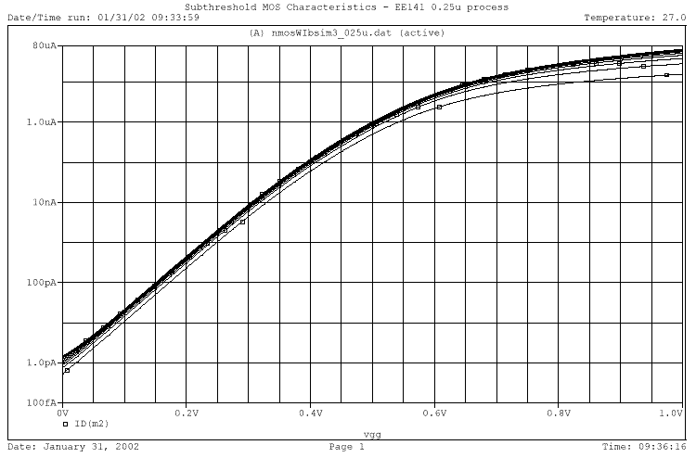
Subthreshold I_{D} vs V_{GS}
I_{D} = I_{S} e ^{(qV}GS^{/nkT)} (1 - e ^{–(qV}DS^{/kT)})(1 + λV_{DS})
V_{DS} from 0 to 0.5V

Slide 30
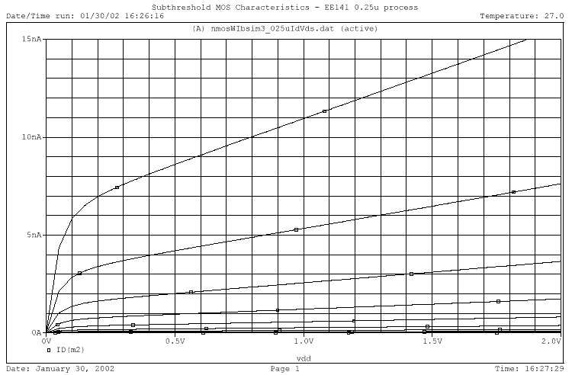
Subthreshold I_{D} vs V_{DS}
I_{D} = I_{S} e ^{(qV}GS^{/nkT)} (1 - e ^{–(qV}DS^{/kT)})(1 + λV_{DS})
V_{GS} from 0 to 0.3V

Slide 31
Threshold Variations
V
T
V
T
Long-channel threshold
Low
V
DS
threshold
V_{DS}
L
Threshold as a function of
Drain-induced barrier lowering
the length (for low
V
DS
)
(for low
L
)

Slide 32
Next Time: The CMOS Inverter
V_{DD}
V_{in}
V_{out}
C_{L}

Slide 33
Next Lecture and Reminders
Next lecture
  CMOS inverter – a static view
    Reading assignment – Rabaey, et al, 5.1-5.3
Reminders
  HW1 due September 10th (one week)
  Project Title due September 12th (one week from Thursday)
  Evening midterm exam scheduled
    Wednesday, October 10th from 8:15 to 10:15pm in 260 Willard

